Slide 1
Senate Joint Resolution (SJR) 10: School Data Collection Systems and Processes
The Office of Public Instruction

Slide 2
Findings and Recommendations
Data governance structure within OPI and how OPI transmits and retains student data.
Audit work visited 10 school districts and surveyed over 400 school districts.
Strengthening data governance activities
Updating and clarifying data governance policies
Including district stakeholders in data governance
Working with the K-12 data task force
Addressing existing student data security risks
Assessing potential threats to student data security

Slide 3
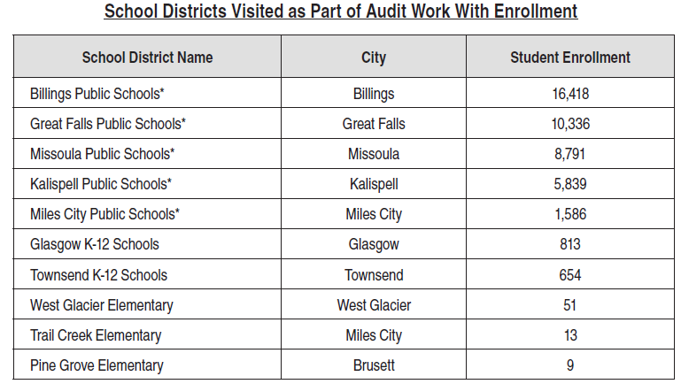
School District Observations

Slide 4
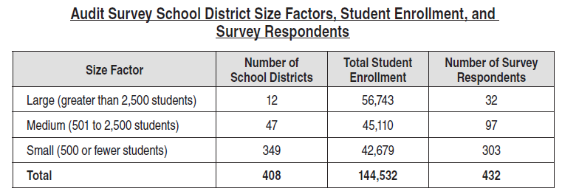
School District Observations

Slide 5
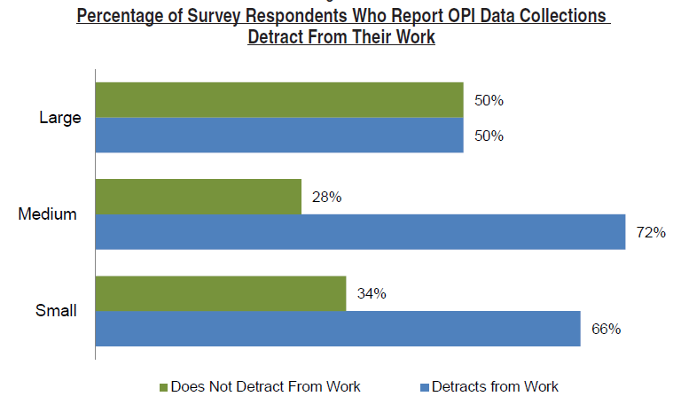
School District Observations

Slide 6
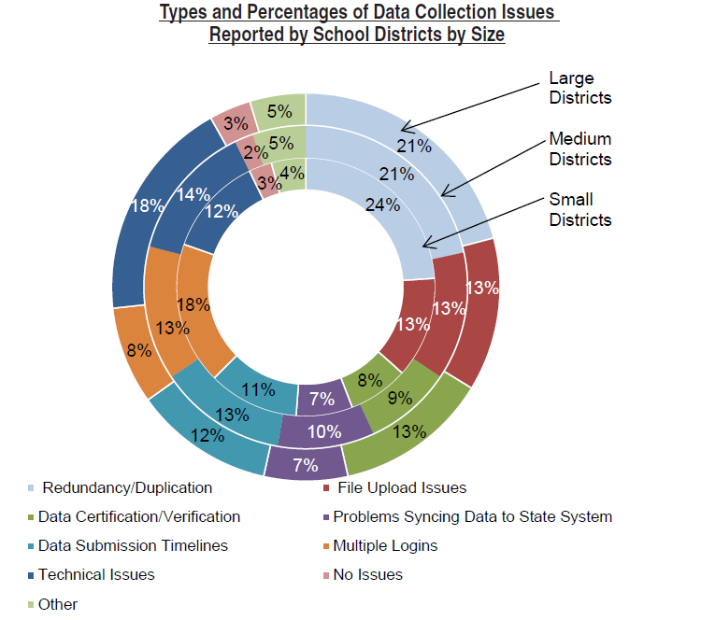
School District Observations

Slide 7
Data Governance
The effectiveness of OPI’s data governance structure is limited.
Strengthening and prioritizing data governance activities.
Updating and clarifying data governance responsibilities for staff.
Including structured input from district stakeholders.

Slide 8
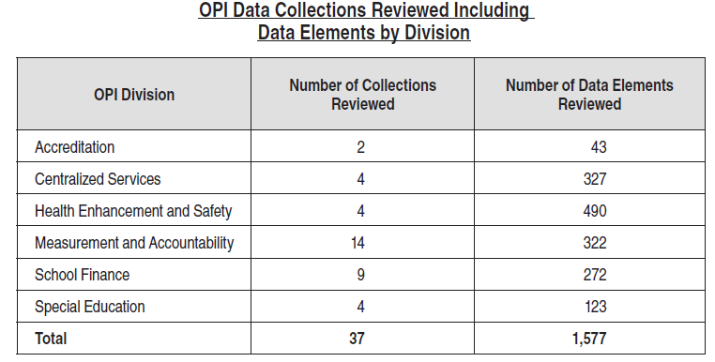
Data Collections
The effectiveness of OPI’s data governance structure is limited.

Slide 9
Data Collections
OPI collects information not required by state or federal mandates, including data related to special education and school district salary information.
There may be opportunities for reducing potential collection redundancies; OPI has made efforts to improve data collections.
Recommendation
Strengthen data governance by incorporating the periodic review of OPI data collections for duplication, legal requirements, and potential information technology system consolidations.

Slide 10
Request Review Process
The request review process is not conducted uniformly, with staff inconsistently participating in data governance.
OPI staff don’t clearly understand the purpose of the process, including what constitutes a data collection.
Recommendation
Update and clarify agency policies and procedures for staff data governance requirements, including training staff on those requirements.

Slide 11
School District Involvement
OPI doesn’t include local school districts in data governance.
Districts of all sizes collectively reported that they had little knowledge of data governance.
OPI staff indicated that school districts have not provided specific examples of redundancy and duplication.

Slide 12
School District Involvement
OPI staff view data governance as internal and voluntary, with no plans to support beyond federal resources.
Other states include external stakeholders as part of data governance efforts.
Recommendation
Include structured input from key stakeholders and develop a sustainability plan for maintaining data governance.

Slide 13
K-12 Data Task Force
State law establishes a K-12 data task to analyze the best options for a statewide data system, including resolving repetition and redundancy.
OPI doesn’t see a clear purpose for the task force, increasing stakeholder dissatisfaction.
Recommendation
Continually work in consultation with the statutory K-12 Data Task Force.

Slide 14
Student Data Security
OPI needs to strengthen how it maintains the individual privacy of students and their families.
The Achievement in Montana (AIM) system is the primary student information system where OPI collects personally identifiable information (PII).
Audit work examined AIM access and business process controls related to data security.

Slide 15
Student Data Security
Audit work found that limited business process controls at OPI have compromised the confidentiality of student data.
AIM Account Access
Email
Physical Security
Security Training
Mobile Device Management
Research Agreements

Slide 16
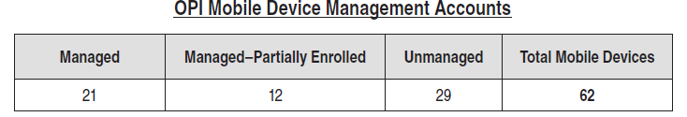
Student Data Security
Email
Audit work identified unsecure emails containing PII transmitted between OPI staff and from school districts to OPI.
Mobile Device Management
OPI currently has staff with unmanaged mobile devices with routine access to student data.

Slide 17
Student Data Security
Security Training
OPI has not implemented required annual security training for staff.
Monitoring
State agencies are required to evaluate and monitor data security.
Recommendation
Monitor and evaluate employee compliance with OPI’s Student Records Confidentiality Policy and implement procedures to mitigate data security risk factors.

Slide 18
Student Data Security
Assessing risk is a basic information security practice.
Risk management enables an organization to prioritize resources and determine what level of risk is acceptable.
Recommendation
Prioritize and implement measures to assess and document risks and potential threats to student data security.

Slide 19
Questions?

